Slide 1

Does the series $e^{A}$ (matrix exponential) converge absolutely, where A is Any $ℂ^{nxn}$ Matrix?
Presenter : Ashalynn Davis
Faculty Advisor: Walfredo Javier

Slide 2
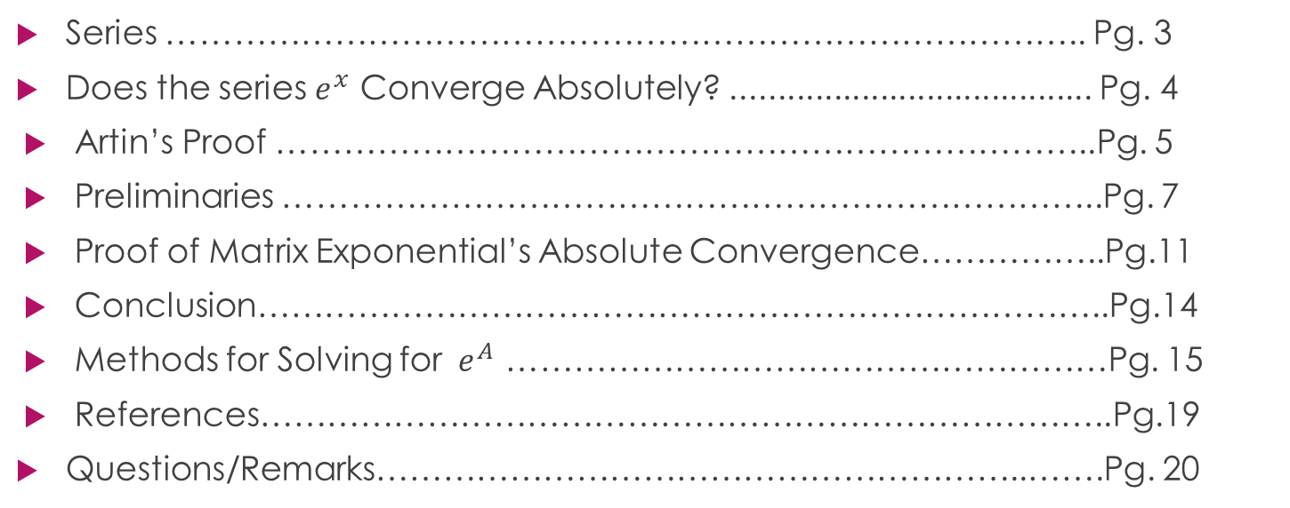
Table of Contents
Series ……………………………………………………………………….. Pg. 3
Does the series $e^{x}$ Converge Absolutely? ....................................... Pg. 4
Artin’s Proof ………………………………………………………………..Pg. 5
Preliminaries ………………………………………………………………..Pg. 7
Proof of Matrix Exponential’s Absolute Convergence……………..Pg.11
Conclusion…………………………………………………………………..Pg.14
Methods for Solving for ${ e}^{A}$ ………………………………………………Pg. 15
References…………………………………………………………………..Pg.19
Questions/Remarks…………………………………………………..…….Pg. 20

Slide 3
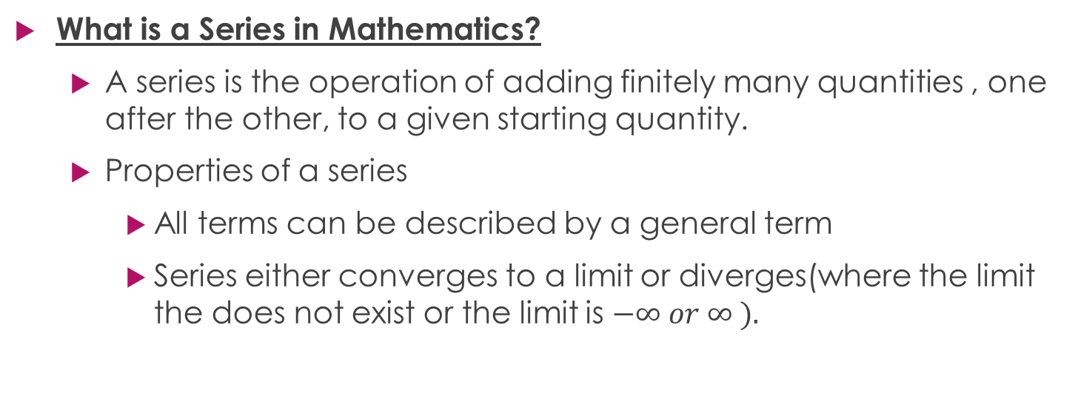
Series (2)
What is a Series in Mathematics?
A series is the operation of adding finitely many quantities , one after the other, to a given starting quantity.
Properties of a series
All terms can be described by a general term
Series either converges to a limit or diverges(where the limit the does not exist or the limit is $−∞ or ∞ ).$

Slide 4
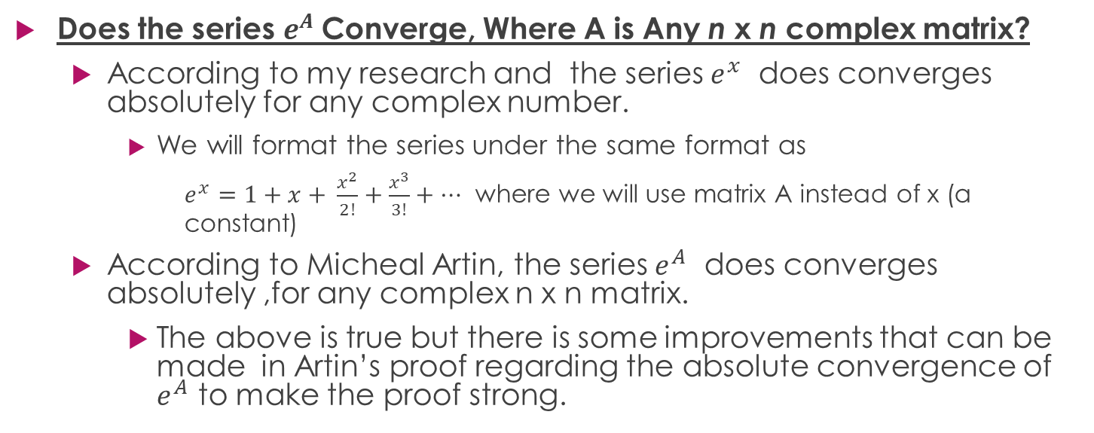

Does the series $of e^{A}$ Converge Absolutely? (1)
Does the series $e^{A}$ Converge, Where A is Any n x n complex matrix?
According to my research and the series $e^{x}$ does converges absolutely for any complex number.
We will format the series under the same format as
$e^{x}=1+x+ \frac{x^{2}}{2!}+\frac{x^{3}}{3!}+…$ where we will use matrix A instead of x (a constant)
According to Micheal Artin, the series $e^{A}$ does converges absolutely ,for any complex n x n matrix.
The above is true but there is some improvements that can be made in Artin’s proof regarding the absolute convergence of $e^{A}$ to make the proof strong.

Slide 5
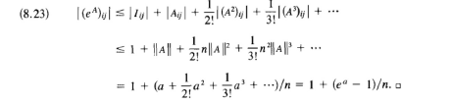
Artin’s Proof (Part 1 of 2 ) (1)

Slide 6
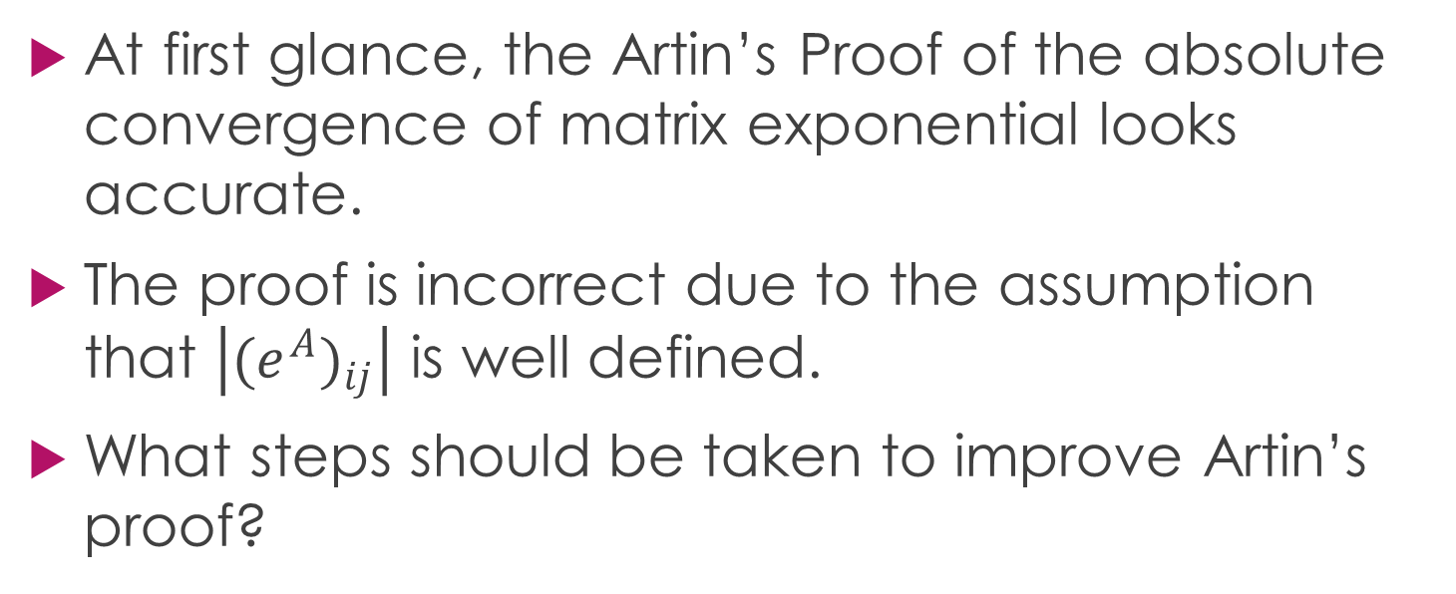
Artin’s Proof (Part 2 of 2) (1)
At first glance, the Artin’s Proof of the absolute convergence of matrix exponential looks accurate.
The proof is incorrect due to the assumption that $\left|{{(e}^{A})}_{ij}\right|$ is well defined.
What steps should be taken to improve Artin’s proof?

Slide 7
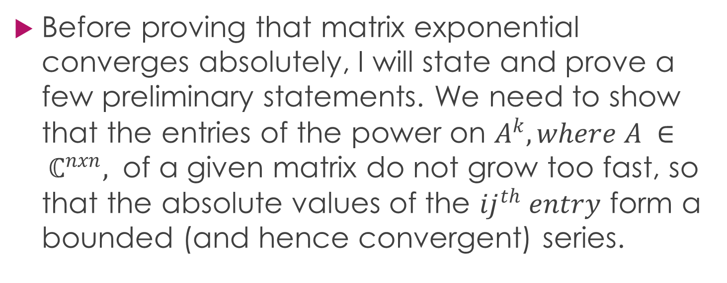
Preliminaries (1 of 4 ) (1)
Before proving that matrix exponential converges absolutely, I will state and prove a few preliminary statements. We need to show that the entries of the power on $A^{k}, where A ∈ ℂ^{nxn},$ of a given matrix do not grow too fast, so that the absolute values of the ${ij}^{th} entry$ form a bounded (and hence convergent) series.

Slide 8
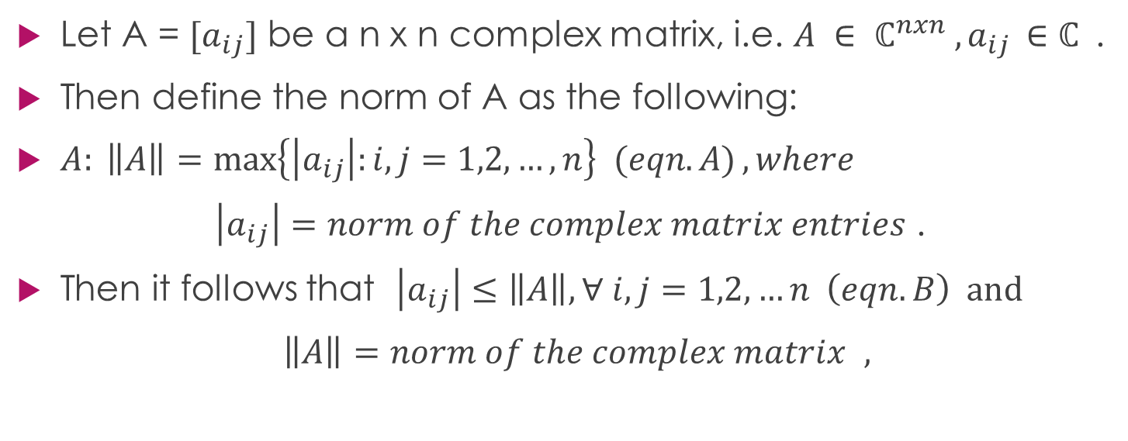
Preliminaries (2 of 4 ) (1)
Let A = ${[a}_{ij}]$ be a n x n complex matrix, i.e. $A ∈ ℂ^{nxn} , a_{ij }∈ℂ$.
Then define the norm of A as the following:
$A: \left\|A\right\|=\max\left\{\left|a_{ij}\right|:i,j=1,2,…,n\right\} (eqn. A), where$
$\left|a_{ij}\right|=norm of the complex matrix entries$ .
Then it follows that $\left|a_{ij}\right|≤\left\|A\right\|, ∀ i,j=1,2,…n \left(eqn.B\right) and$
$\left\|A\right\|=norm of the complex matrix$ $,$

Slide 9
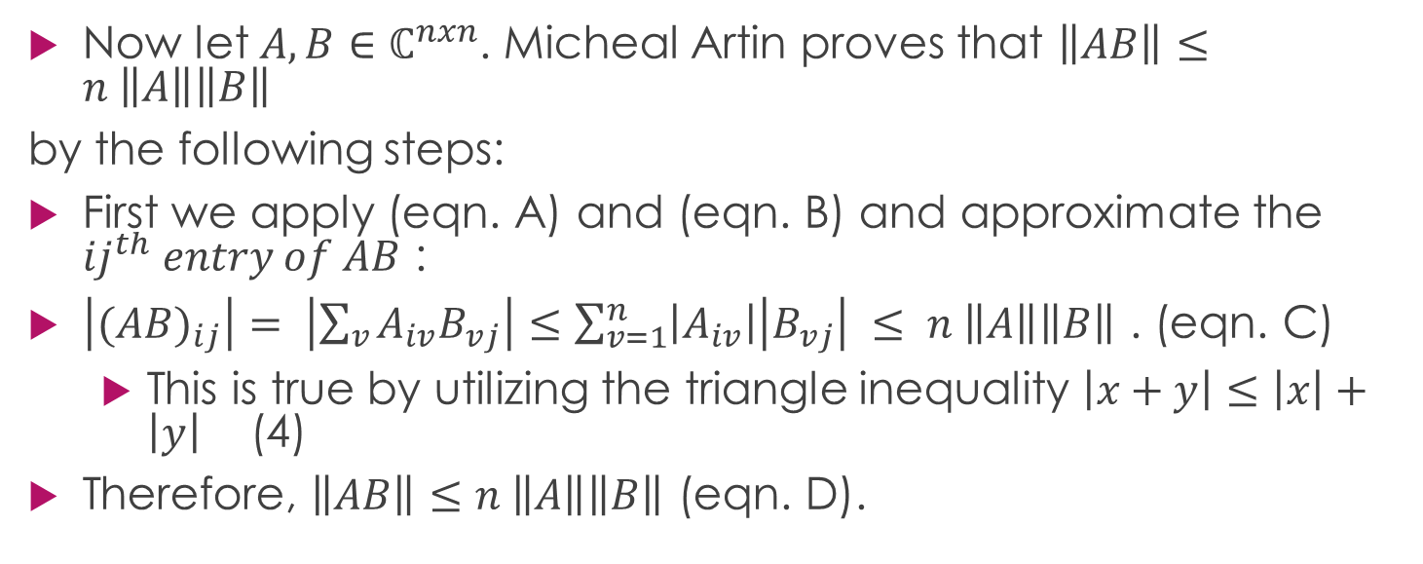
Preliminaries (3 of 4) (1)(4)
Now let $A,B∈$ $ℂ^{nxn}$. Micheal Artin proves that $\left\|AB\right\|≤n \left\|A\right\|\left\|B\right\|$
by the following steps:
First we apply (eqn. A) and (eqn. B) and approximate the ${ij}^{th} entry of AB$ :
$\left|{(AB)}_{ij}\right|= \left|\sum_{v}{A_{iv}B_{vj}}\right|≤\sum_{v=1}^{n}{\left|A_{iv}\right|\left|B_{vj}\right|} ≤ n \left\|A\right\|\left\|B\right\|$ . (eqn. C)
This is true by utilizing the triangle inequality $\left|x+y\right|≤\left|x\right|+\left|y\right|$ (4)
Therefore, $\left\|AB\right\|≤n \left\|A\right\|\left\|B\right\|$ (eqn. D).

Slide 10
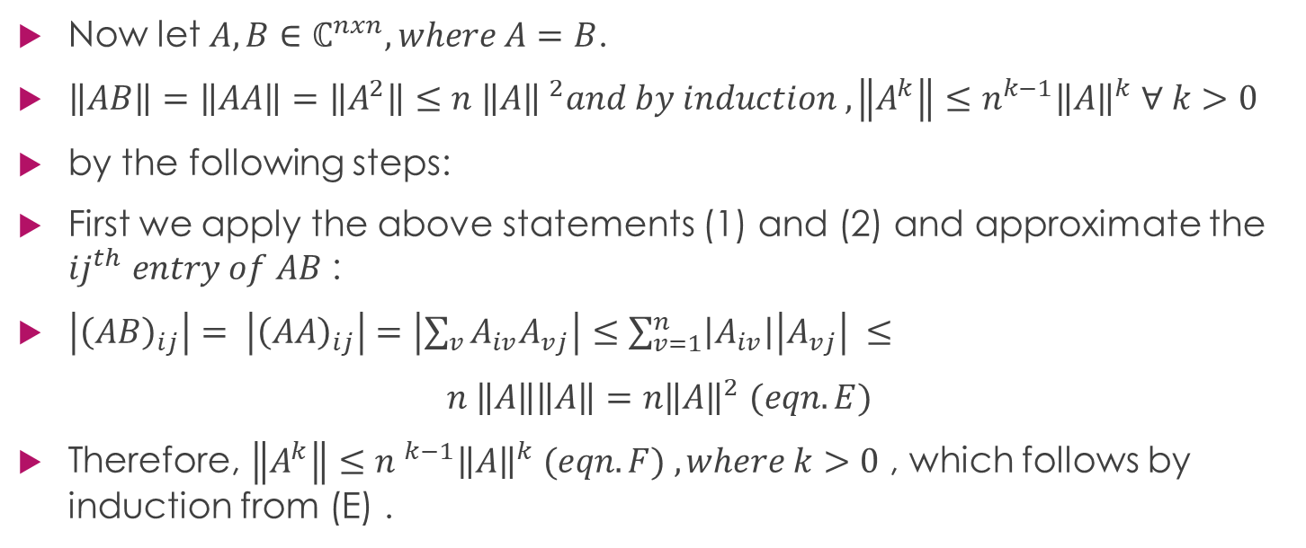
Preliminaries (4 of 4) (1)(4)
Now let $A,B∈$ $ℂ^{nxn}, where A=B$.
$\left\|AB\right\|=\left\|AA\right\|=\left\|A^{2}\right\|≤n {\left\|A\right\| }^{2}and by induction ,\left\|A^{k}\right\|≤n^{k−1}{\left\|A\right\|}^{k} ∀ k>0$
by the following steps:
First we apply the above statements (1) and (2) and approximate the ${ij}^{th} entry of AB$ :
$\left|{\left(AB\right)}_{ij}\right|= \left|{\left(AA\right)}_{ij}\right|=\left|\sum_{v}{A_{iv}A_{vj}}\right|≤\sum_{v=1}^{n}{\left|A_{iv}\right|\left|A_{vj}\right|} ≤$
$n \left\|A\right\|\left\|A\right\|=n{\left\|A\right\|}^{2} (eqn.E)$
Therefore, $\left\|A^{k}\right\|≤{n }^{k−1}{\left\|A\right\|}^{k} (eqn. F) , where k>0$ , which follows by induction from (E) .

Slide 11

Proof of Matrix Exponential’s Absolute Convergence (Part 1 of 3 ) (1)
Let us consider the series $I+A+\frac{A^{2}}{2!}+\frac{A^{3}}{3!}+…$ , we want to show that this series converges.
Let us look at the i,j entry of $I+A+\frac{A^{2}}{2!}+\frac{A^{3}}{3!}+…$
$1+A_{ij}+\frac{{(A_{ij})}^{2}}{2!}+\frac{{(A_{ij})}^{3}}{3!}+…$
Let $μ=\left\|A\right\|$
Consider
$1+\left|A_{ij}\right|+\frac{{\left|(A_{ij})\right|}^{2}}{2!}+\frac{{\left|(A_{ij})\right|}^{3}}{3!}+…$

Slide 12
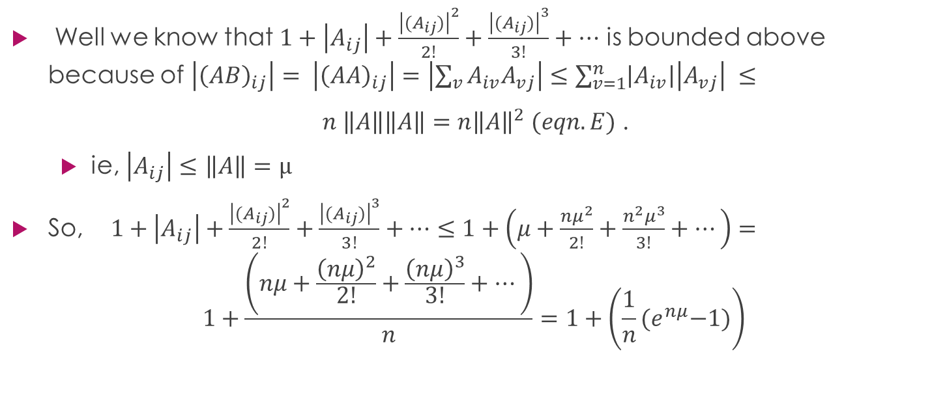
Proof of Matrix Exponential’s Absolute Convergence (Part 2 of 3) (1)
Well we know that $1+\left|A_{ij}\right|+\frac{{\left|(A_{ij})\right|}^{2}}{2!}+\frac{{\left|(A_{ij})\right|}^{3}}{3!}+…$ is bounded above because of $\left|{\left(AB\right)}_{ij}\right|= \left|{\left(AA\right)}_{ij}\right|=\left|\sum_{v}{A_{iv}A_{vj}}\right|≤\sum_{v=1}^{n}{\left|A_{iv}\right|\left|A_{vj}\right|} ≤$
$n \left\|A\right\|\left\|A\right\|=n{\left\|A\right\|}^{2} (eqn.E)$ .
ie, $\left|A_{ij}\right|≤$ $\left\|A\right\|=μ$
So,$1+\left|A_{ij}\right|+\frac{{\left|(A_{ij})\right|}^{2}}{2!}+\frac{{\left|(A_{ij})\right|}^{3}}{3!}+…≤1+\left(μ+\frac{nμ^{2}}{2!}+\frac{n^{2}μ^{3}}{3!}+…\right)=$
$$1+\frac{\left(nμ+\frac{{\left(nμ\right)}^{2}}{2!}+\frac{{\left(nμ\right)}^{3}}{3!}+…\right)}{n}=1+\left(\frac{1}{n}{(e}^{nμ}−1)\right)$$

Slide 13
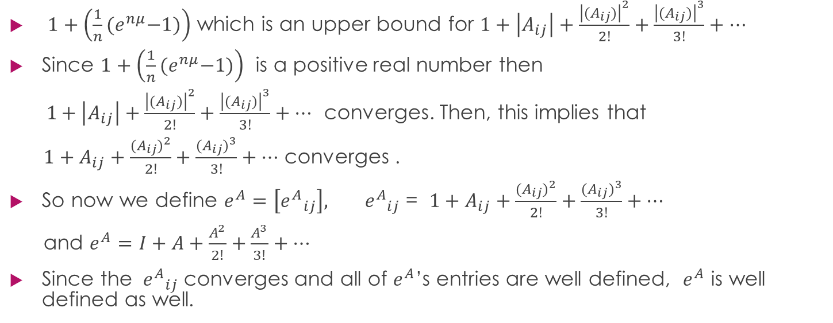
Proof of Matrix Exponential’s Absolute Convergence (Part 2 of 3) (1)
$1+\left(\frac{1}{n}{(e}^{nμ}−1)\right)$ which is an upper bound for $1+\left|A_{ij}\right|+\frac{{\left|(A_{ij})\right|}^{2}}{2!}+\frac{{\left|(A_{ij})\right|}^{3}}{3!}+…$
Since $1+\left(\frac{1}{n}{(e}^{nμ}−1)\right)$ is a positive real number then
$1+\left|A_{ij}\right|+\frac{{\left|(A_{ij})\right|}^{2}}{2!}+\frac{{\left|(A_{ij})\right|}^{3}}{3!}+…$ converges. Then, this implies that
$1+A_{ij}+\frac{{(A_{ij})}^{2}}{2!}+\frac{{(A_{ij})}^{3}}{3!}+…$ converges .
So now we define $e^{A}=\left[{e^{A}}_{ij}\right], { e^{A}}_{ij}$ = $1+A_{ij}+\frac{{(A_{ij})}^{2}}{2!}+\frac{{(A_{ij})}^{3}}{3!}+…$
and $e^{A}=I+A+\frac{A^{2}}{2!}+\frac{A^{3}}{3!}+…$
Since the ${ e^{A}}_{ij}$converges and all of $e^{A}$’s entries are well defined, $e^{A}$ is well defined as well.

Slide 14
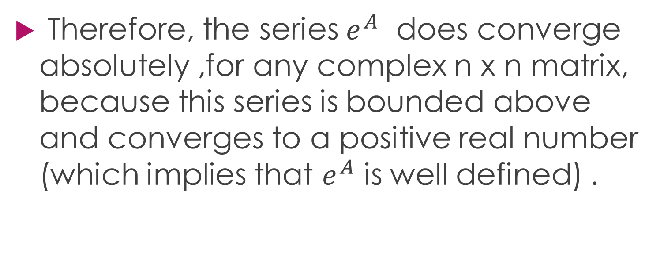
Conclusion
Therefore, the series $e^{A}$ does converge absolutely ,for any complex n x n matrix, because this series is bounded above and converges to a positive real number (which implies that $e^{A}$ is well defined) .

Slide 15
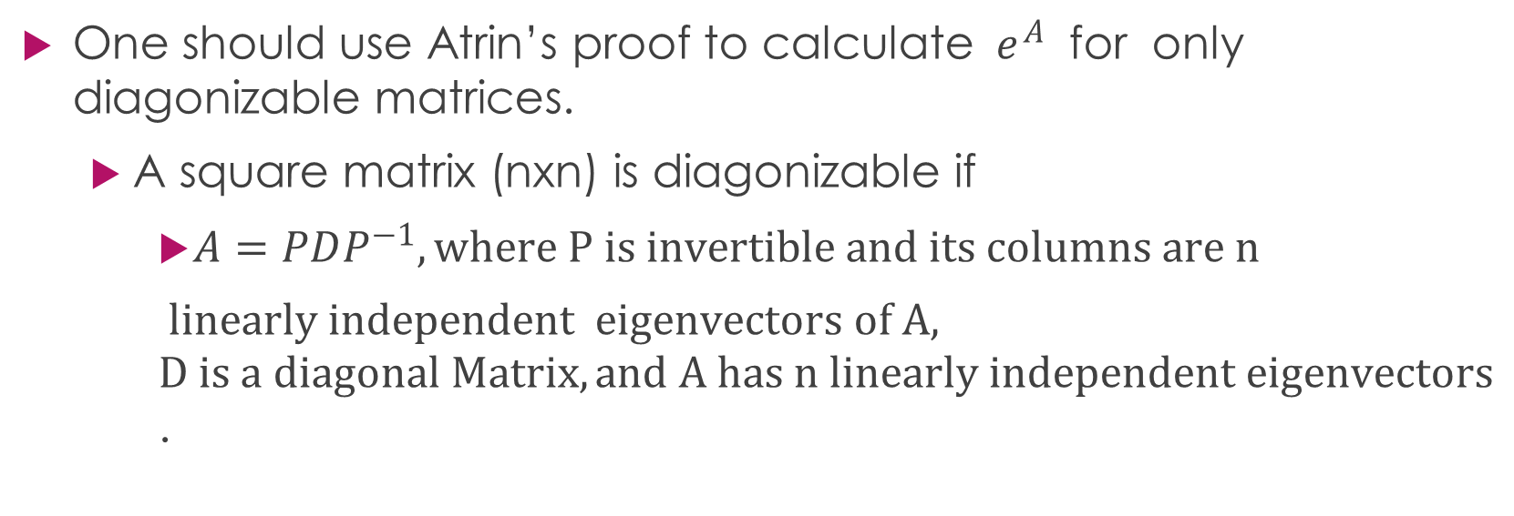

Methods for Solving for ${ e}^{A}$ (Part 1 of 4) (1)
One should use Atrin’s proof to calculate ${ e}^{A}$ for only diagonizable matrices.
A square matrix (nxn) is diagonizable if
$A=PDP^{−1}, where P is invertible and its columns are n$
$linearly independent eigenvectors of A, D is a diagonal Matrix, and A has n linearly independent eigenvectors$.

Slide 16
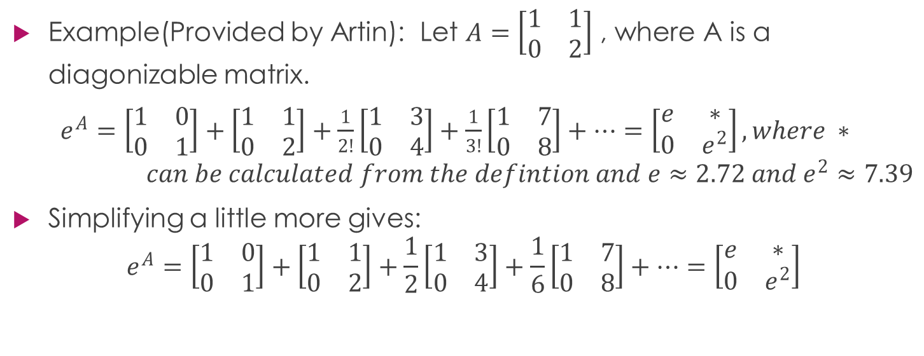

Methods for Solving for ${ e}^{A}$ (Part 2 of 4) (1)
Example(Provided by Artin): Let $A=\left[\begin{matrix}1 & 1 \\ 0 & 2\end{matrix}\right]$ , where A is a diagonizable matrix.
$e^{A}=\left[\begin{matrix}1 & 0 \\ 0 & 1\end{matrix}\right]+\left[\begin{matrix}1 & 1 \\ 0 & 2\end{matrix}\right]+\frac{1}{2!}\left[\begin{matrix}1 & 3 \\ 0 & 4\end{matrix}\right]+\frac{1}{3!}\left[\begin{matrix}1 & 7 \\ 0 & 8\end{matrix}\right]+…=\left[\begin{matrix}e & ∗ \\ 0 & e^{2}\end{matrix}\right],where ∗ can be calculated from the defintion and e≈2.72 and e^{2}≈7.39$
Simplifying a little more gives:
$$e^{A}=\left[\begin{matrix}1 & 0 \\ 0 & 1\end{matrix}\right]+\left[\begin{matrix}1 & 1 \\ 0 & 2\end{matrix}\right]+\frac{1}{2}\left[\begin{matrix}1 & 3 \\ 0 & 4\end{matrix}\right]+\frac{1}{6}\left[\begin{matrix}1 & 7 \\ 0 & 8\end{matrix}\right]+…=\left[\begin{matrix}e & ∗ \\ 0 & e^{2}\end{matrix}\right]$$

Slide 17
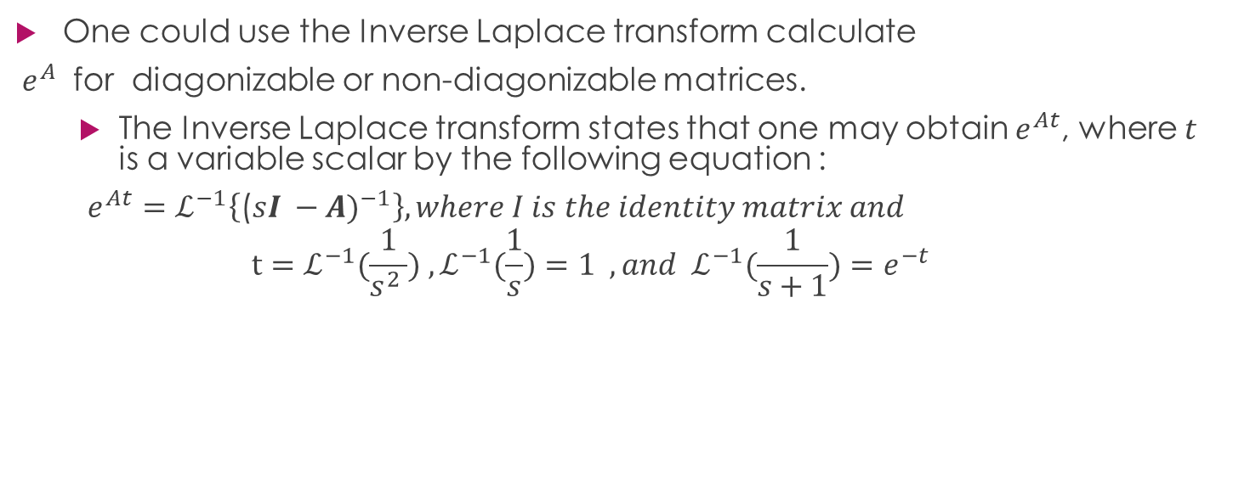

Methods for Solving for ${ e}^{A}$ (Part 3 of 4) (2)(3)
One could use the Inverse Laplace transform calculate
${ e}^{A}$ for diagonizable or non-diagonizable matrices.
The Inverse Laplace transform states that one may obtain $e^{At}$, where $t$ is a variable scalar by the following equation :
$e^{At}=ℒ^{−1}\left\{\text{(}{sI −A)}^{−1}\right\}, where I is the identity matrix and$
$$t=ℒ^{−1}(\frac{1}{s^{2} }) ,ℒ^{−1}(\frac{1}{s})=1 ,and{ ℒ}^{−1}(\frac{1}{s+1})=e^{−t}$$

Slide 18
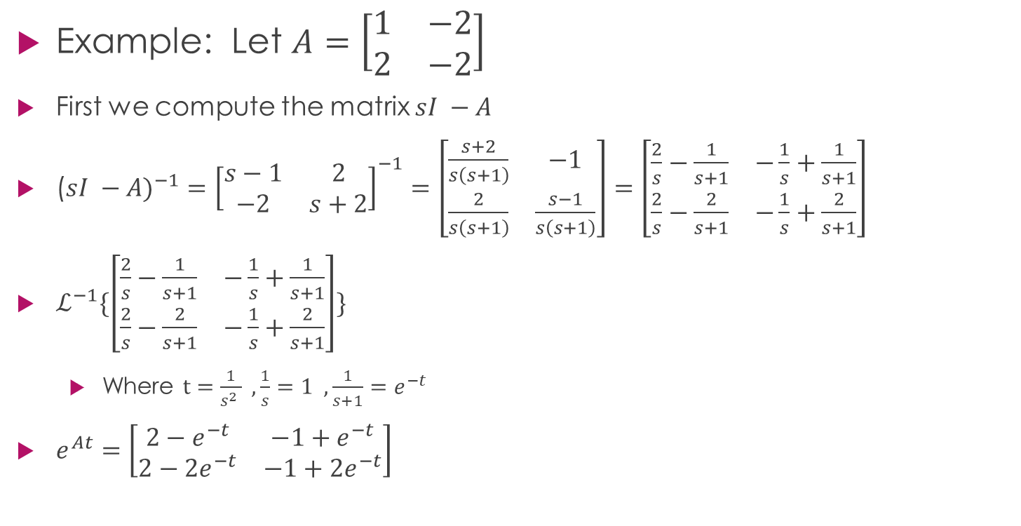

Methods for Solving for ${ e}^{A}$ (Part 3 of 4) (2)
Example: Let $A=\left[\begin{matrix}1 & −2 \\ 2 & −2\end{matrix}\right]$
First we compute the matrix $sI −A$
(${sI −A)}^{−1}={\left[\begin{matrix}s−1 & 2 \\ −2 & s+2\end{matrix}\right]}^{−1}=\left[\begin{matrix}\frac{s+2}{s\left(s+1\right)} & −1 \\ \frac{2}{s\left(s+1\right)} & \frac{s−1}{s\left(s+1\right)}\end{matrix}\right]=\left[\begin{matrix}\frac{2}{s}−\frac{1}{s+1} & −\frac{1}{s}+\frac{1}{s+1} \\ \frac{2}{s}−\frac{2}{s+1} & −\frac{1}{s}+\frac{2}{s+1}\end{matrix}\right]$
$ℒ^{−1}\{\left[\begin{matrix}\frac{2}{s}−\frac{1}{s+1} & −\frac{1}{s}+\frac{1}{s+1} \\ \frac{2}{s}−\frac{2}{s+1} & −\frac{1}{s}+\frac{2}{s+1}\end{matrix}\right]\}$
Where $t=\frac{1}{s^{2} } , \frac{1}{s}=1 ,\frac{1}{s+1}=e^{−t}$
$e^{At}=\left[\begin{matrix}2−e^{−t} & −1+e^{−t} \\ 2−2e^{−t} & {−1+2e}^{−t}\end{matrix}\right]$

Slide 19
References
(1)
“Linear Transformations: The Matrix Exponential.” Algebra, by Michael Artin, Pearson Education, 2011.
(2)
Zill, Dennis G. A First Course in Differential Equations with Modeling Applications. Thomson/Brooks/Cole, 2005. pp.276-318, pp.360-362
(3)
Boyd, Stephen. “Solution via Laplace Transform and Matrix Exponential.” 2008.
(4)
Weisstein, Eric W. "Triangle Inequality." From MathWorld--A Wolfram Web Resource. http://mathworld.wolfram.com/TriangleInequality.html

Slide 20
Questions/Remarks
????????????

